Slide 1
Chat Log
Gabriel Lopez

Slide 2
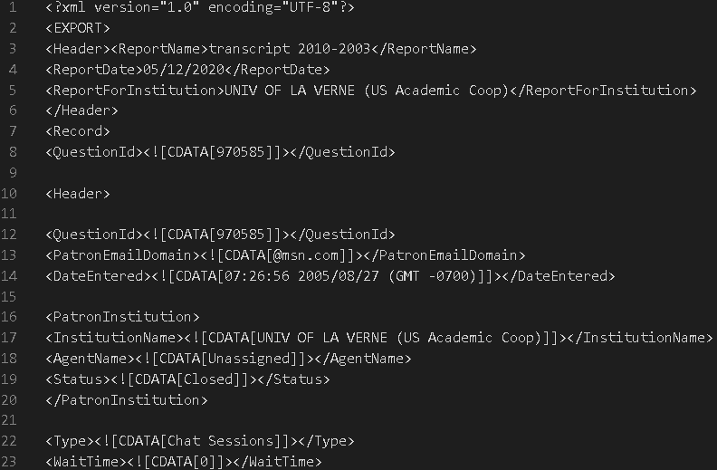
The Data
Dated from 2003 to 2013
Saved from Wilson Library in XML files
Conversations between student and librarian

Slide 3

Gensim
“Topic modelling for humans”
Open source API that allows anyone to train their own models.
Python
Topic Modeling
Machine learning technique that interprets a document and finds patterns in the words and phrases and uses them to draw conclusions about the document.

Slide 4
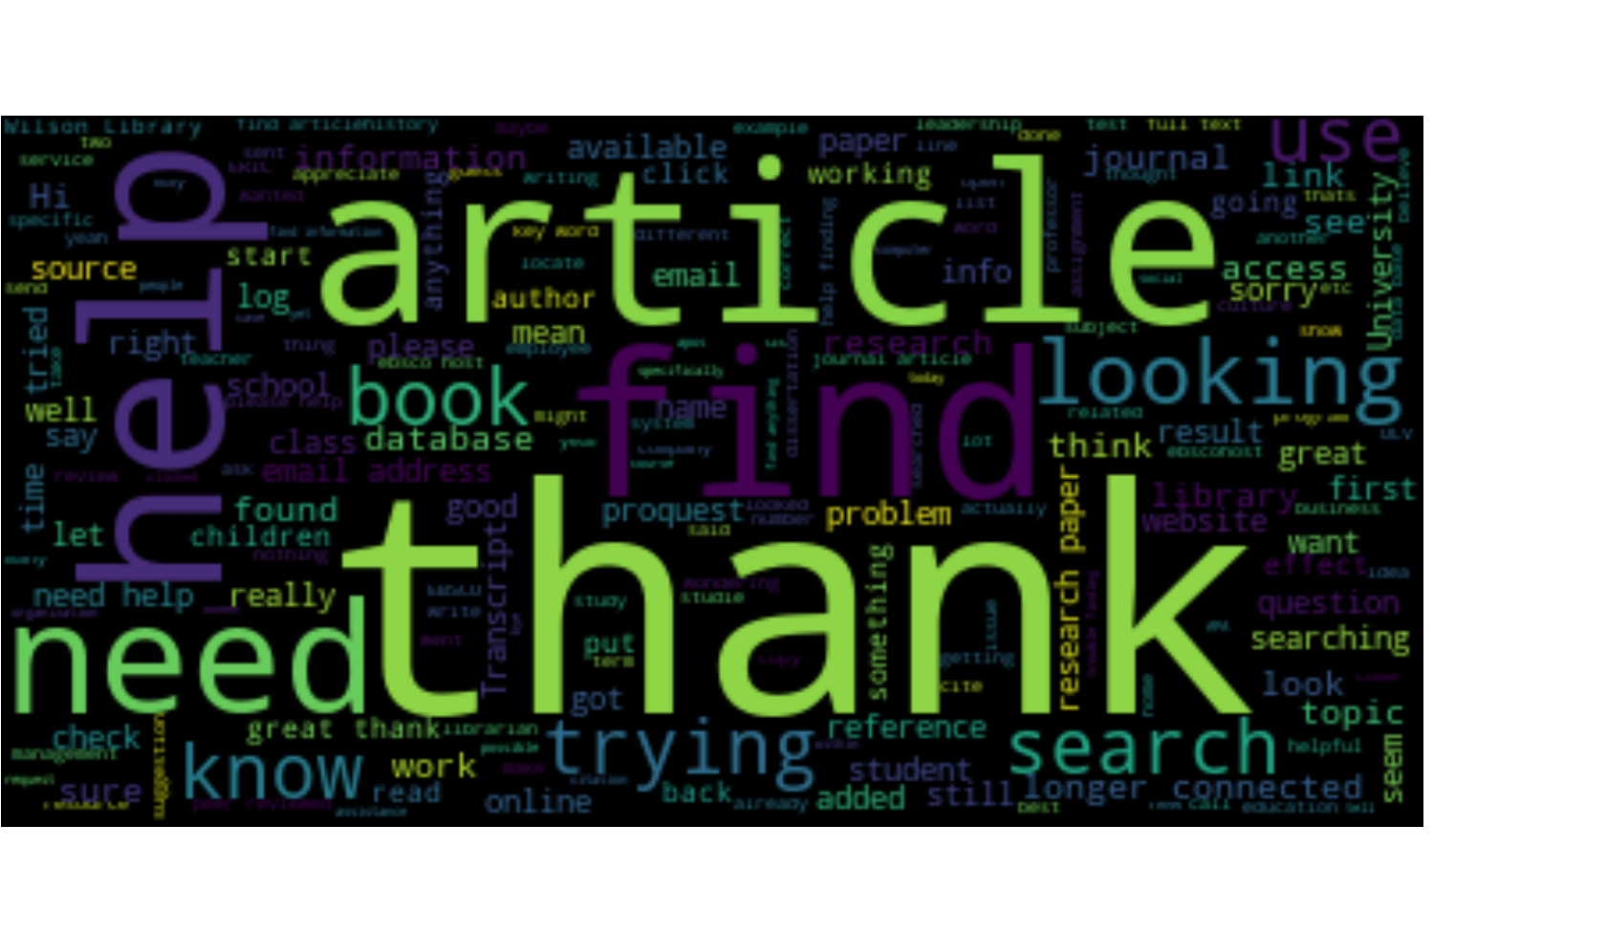
Word Cloud
A word cloud is a topic modeling visualization where the top words used are shown in a picture with size of the word directly correlating with the amount it is used in the processed text. The larger the word the more it was used and vise versa.

Slide 5
Word2Vec Model
Word2Vec is a widely used algorithm based on neural networks, commonly referred to as “deep learning” (though word2vec itself is rather shallow). Using large amounts of unannotated plain text, word2vec learns relationships between words automatically. The output are vectors, one vector per word, with remarkable linear relationships that allow us to do things like:
vec(“king”) - vec(“man”) + vec(“woman”) =~ vec(“queen”)
vec(“Montreal Canadiens”) – vec(“Montreal”) + vec(“Toronto”) =~ vec(“Toronto Maple Leafs”).
Notes:
Say that this is from gensim website as source

Slide 6
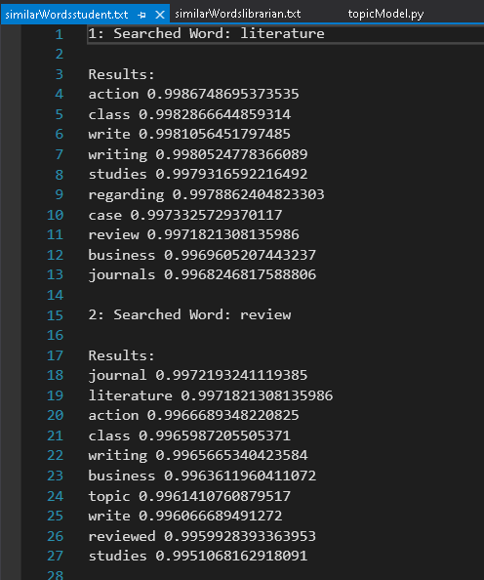
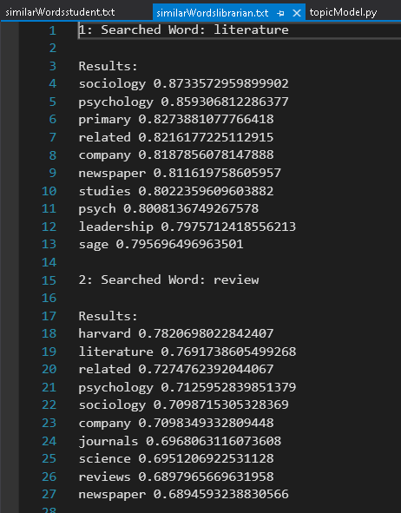
Student and Librarian Similar Words

Slide 7
Cites
https://radimrehurek.com/gensim/
https://radimrehurek.com/gensim/auto_examples/tutorials/run_word2vec.html#sphx-glr-auto-examples-tutorials-run-word2vec-py

